Slide 1
Solutions, Solvents, and Solutes
D. Crowley, 2007

Slide 2

Solutions, Solvents & Solutes
To understand the terms solution, solute, soluble, insoluble, dissolve and solvent

Slide 3
Pure or Mixture
Look at the different liquids - are these pure, or are they mixtures? Explain your answer with reference to particles…
So, if lots are things are jumbled up together we have a mixture, e.g. sea water is a mixture of water particles, salt particles, different chemical particles etc…
Look at this ‘pure’ water - what happens when some sugar is added to it?
I now have a mixture of water & sugar; but the sugar seems to have disappeared!
What has happened?
Notes:
The different liquids should be: clear water, colored water, flour (or cornstarch) in water, sand in water, have sugar ready to create a sugar water solution.

Slide 4
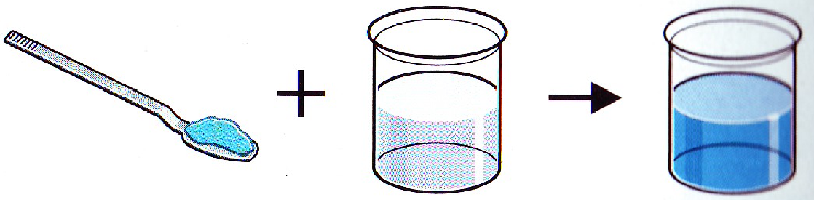
Pure?!
Even though the water still looks ‘pure’, this term is wrong. Pure would mean there were only water particles, however we now have water particles + sugar particles!
The sugar has not disappeared - instead it has dissolved in the water
We would call the water + sugar a solution
A solid dissolved in a liquid makes a solution
In a solution the liquid is called the solvent, and the solid is called the solute
Solute
Solvent
Solution

Slide 5
Matter (Solid, Liquid, Gas)
Pure Substances
- Only one kind of particle in it.
Mixtures
- Will have two or more parts that are not chemically combined, only physically combined
Suspension
- Each substance keeps properties and can be separated to original form
Solutions
They’re mixed together so well you only see one thing – it looks pure but it isn’t
A solute is the substance to be dissolved (sugar).
The solvent is the one doing the dissolving (water).

Slide 6
Examples
Mixtures
Solutions
Chex Mix
Raisin Bran
Pizza
Sand
Soda
Gasoline
Brass (Zinc/Copper)
Vinegar

Slide 7

They all sound the same!
Solute
Solvent
Solution
These words need to be learned - however, be careful because they all sound pretty similar!
Solution - the mixture formed when a substance dissolves in it
Solute - the substance that dissolves
Solvent - the liquid in the solution
Dissolve - mixing of a substance in a liquid
Soluble - a substance which can dissolve (mix in a liquid)
Insoluble - a substance which cannot dissolve (mix in a liquid)

Slide 8
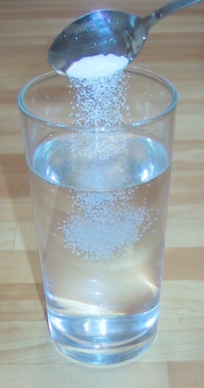
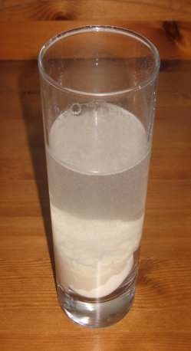
Examples
Solution - the mixture formed when a substance dissolves in it
Solute - the substance that dissolves
Solvent - the liquid in the solution
Dissolve - mixing of a substance in a liquid
Soluble - a substance which can dissolve (mix in a liquid)
Insoluble - a substance which cannot dissolve (mix in a liquid)
Look at the examples - can you spot the terms?
Salt added to water: -
The solute is the
The solvent is the
This makes a
The salt is as it has
soluble
salt
water
solution
dissolved
Flour added to water. Stirring it makes it go cloudy, but after a while all the flour grains sink to the bottom:
The flours has not
This is because flour is
dissolved
insoluble

Slide 9
Where
Solution - the mixture formed when a substance dissolves in it
Solute - the substance that dissolves
Solvent - the liquid in the solution
Dissolve - mixing of a substance in a liquid
Soluble - a substance which can dissolve (mix in a liquid)
Insoluble - a substance which cannot dissolve (mix in a liquid)
So when a solute dissolves, such as salt in water, where does it go? Does it disappear?
The solute does not disappear - its still there! But you cannot see it because the particles are now mixed up (dissolved)
Look at the particle box below - can you draw a particle box for a solid which has dissolved (e.g. salt in water)
Salt, added to the water
Water

Slide 10
Where
Solution - the mixture formed when a substance dissolves in it
Solute - the substance that dissolves
Solvent - the liquid in the solution
Dissolve - mixing of a substance in a liquid
Soluble - a substance which can dissolve (mix in a liquid)
Insoluble - a substance which cannot dissolve (mix in a liquid)
Particle box for a solid which has dissolved (e.g. salt in water)
Water
Salt, added to the water
The number of salt particles and the number of water particles remains the same - we haven’t lost any salt particles, nor have they got smaller. They’re just spread out amongst the water particles, which is why we can no longer see them (it looks as if the salt has disappeared)!

Slide 11
Where
Solution - the mixture formed when a substance dissolves in it
Solute - the substance that dissolves
Solvent - the liquid in the solution
Dissolve - mixing of a substance in a liquid
Soluble - a substance which can dissolve (mix in a liquid)
Insoluble - a substance which cannot dissolve (mix in a liquid)
Look at the particle box below - can you draw a particle box for an insoluble solid in a liquid (e.g. flour in water)
Flour, added to the water
Water

Slide 12
Where
Solution - the mixture formed when a substance dissolves in it
Solute - the substance that dissolves
Solvent - the liquid in the solution
Dissolve - mixing of a substance in a liquid
Soluble - a substance which can dissolve (mix in a liquid)
Insoluble - a substance which cannot dissolve (mix in a liquid)
Particle box for an insoluble solid in a liquid (e.g. flour in water)
Water
Flour, added to the water
Remember - the number of particles and their size stays the same! However this time we can still see the flour, as the flour particles remain grouped together (no mixing (dissolving))

Slide 13
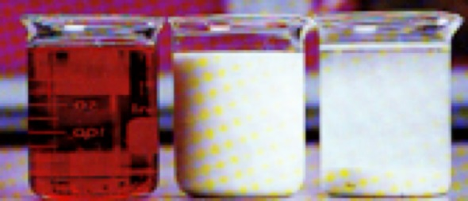
How do we know?
A solution is always transparent - even it has a color
If our liquid remains cloudy, then the solute has not completely dissolved
If a substance will not dissolve (insoluble) then it will settle and be obvious
There is a solution in the first beaker (as it is transparent), even though it is colored red
Milk (second beaker) contains water + fat. The fat has not completely dissolved in the liquid as it is cloudy (Colloid)
Flour is insoluble. This is why it settles at the bottom (stirring makes it go cloudy, but eventually the flour particles settle to the bottom) (Suspension)

Slide 14
Solution - the mixture formed when a substance dissolves in it
Solute - the substance that dissolves
Solvent - the liquid in the solution
Dissolve - mixing of a substance in a liquid
Soluble - a substance which can dissolve (mix in a liquid)
Insoluble - a substance which cannot dissolve (mix in a liquid)
If lots of different things are jumbled up together, we have a mixture. If you mix salt with water then the grains seem to disappear. This is because the grains have split up and mixed with the water. They have dissolved. A substance that dissolves is said to be soluble.
A solid dissolved in liquid makes a solution. In a solution the liquid is called the solvent, and the solid is called the solute. A solid that does not dissolve in a liquid is called insoluble. If a solid has completely dissolved in a liquid, then the solution is always transparent (see-through), even if it has a color.

Slide 15
Solution - the mixture formed when a substance dissolves in it
Solute - the substance that dissolves
Solvent - the liquid in the solution
Dissolve - mixing of a substance in a liquid
Soluble - a substance which can dissolve (mix in a liquid)
Insoluble - a substance which cannot dissolve (mix in a liquid)

